Slide 1
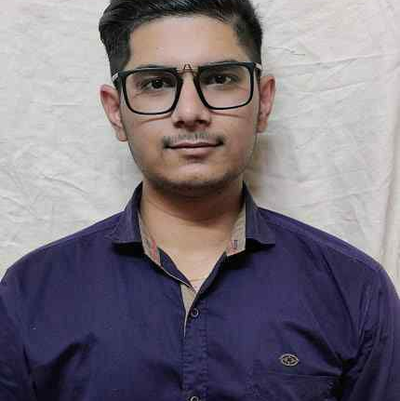


Varun Yadav
Analyst/Software Associate
Bachelor of Computer application
: 2019 - 2022
Skills
C# | Basics, OOPS, Exception Handling, Arrays ,Collection and Generics, Delegates and Events, File Io and Serialization.
.Net | ADO.NET,ASP.NET With MVC and WEB API, Entity Framework
Angular | Components, Services, Modules, Routing, Forms & Validation,Testing
Ado. Net | Basic architecture
Database | Microsoft SQL Server.
Tools | GIT,SSMS, Visual Studio, Visual Studio Code
Cloud | Microsoft Azure AZ 900, ongoing Microsoft training.
UI Technology | HTML5, CSS, JavaScript & Angular
Add on Skills | Communication Skills and Team management.
Mumbai
Varun.a.yadav@capgemini.com
+91 9773712806
A3
Full Stack Developer
Hands on experience on C#, ADO.NET, SQL Server, ASP.NET MVC5 with WEBAPI.
Knowledge on creating Single Page Web Applications using Angular
Hands on experience in developing applications Web pages using HTML5, CSS3, Object Oriented Java Script.
Having Knowledge on Git and GitHub.
Attended training on ITransform-Microsoft.NET
Case study of Online Railway Reservation system using ASP.NET Core with Entity Framework, Web API and SQL Server Management Studio, User Interface created with HTML5, CSS3 JavaScript and Angular. Backend with WEB API and frontend with Angular. It is a Website for Customers who want to book railway reservation tickets from the comfort of their homes
Degreed:
Successfully completed the degreed training in Git, HTML, CSS, SQL, C#, .NET Core, Angular
Technologies used:
ANGULAR JS
ASP.NET CORE
Microsoft SQL Server
Check out my work on GitHub

